Slide 1
Battle of Cowpens, SC 17 January, 1781
Martin A. Howley
LTC, Old Guard of Gate City Guard
02 OCT 2019

Slide 2
Bottom Line Up Front (BLUF)
Cowpens led to Cornwallis’ retreat from the South to Yorktown
Cowpens was decisive victory for Continental Army
Cowpens decimated British Dragoons and large part of British Army
US lost an entire Army at Battle of Camden, SC (Routed), 16 Aug 1780
4,000 US under MG Horatio Gates (900/1K Cap) 2,100 UK under LG Lord Cornwallis
US MG Nathaniel Greene split his forces
Gave “Light Maneuvering” Force to BG Daniel Morgan
The only double envelopment in Revolutionary War
One of the few Cavalry Engagements in Revolutionary War (LTC W)
Hand-Picked terrain
Hernando Cortez – Burn the Boats

Slide 3
Morgan’s Orders and Tactics
Gain “Backwoods” support and live off the land
Raise, train and use militia and skirmishers integrated as significant parts of his fighting force
Made British find and chase him (LTC Tarleton)
Chose Terrain – River at back, Ravine to side, Swamp on other side, two hills at back of funnel
Knew his troops and their abilities (1000-1900)
Knew his enemy (1100-1500)
Three lines
Skirmishers – shoot epaulets
Militia (COL Pickens) –” give me 3 rounds boys”
Continental Army at back
4th - Washington’s Cavalry

Slide 4
Prelude to Battle
Tarleton driving his troops for 3-4 days to engage Morgan
Tarleton assumed this was the usual worn, afraid militia force
Morgan chose time and place of battle
Morgan knew who and what his enemy was
Morgan’s men rested and familiar (with one day) of location
US troops had high morale
Morgan had a layered in-depth plan using each unit’s abilities to their maximum potential
Morgan planned a double envelopment
Morgan kept Cavalry as a hidden surprise element

Slide 5
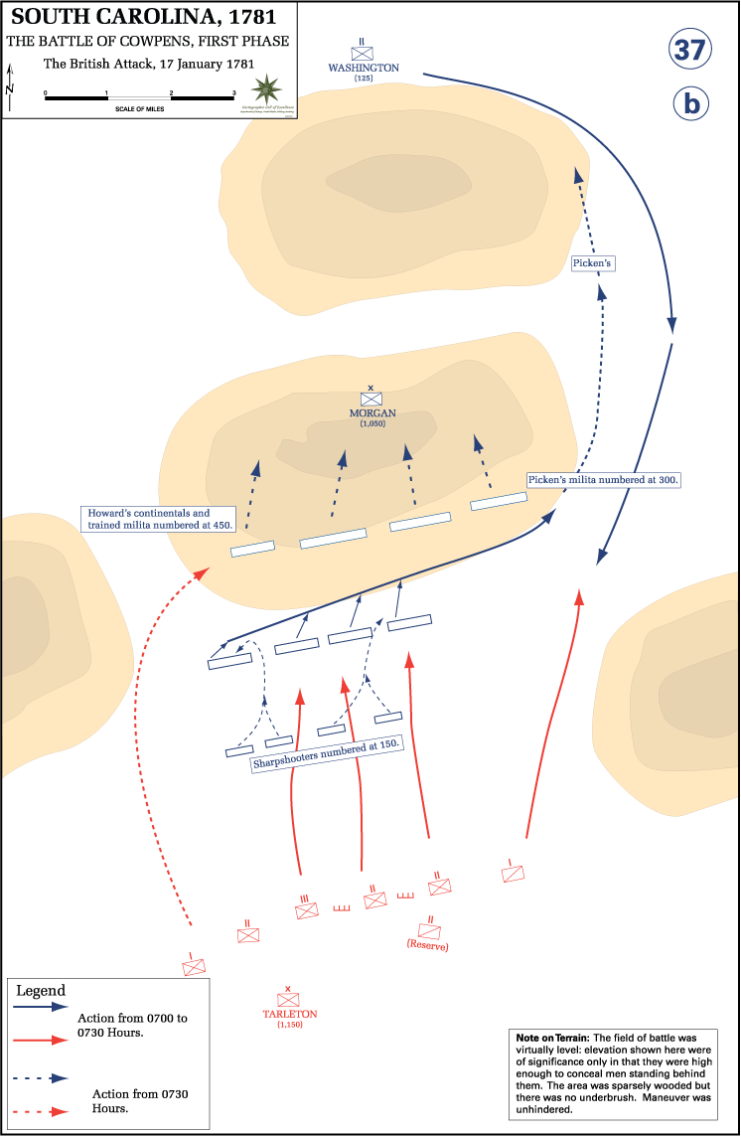
Initial

Slide 6
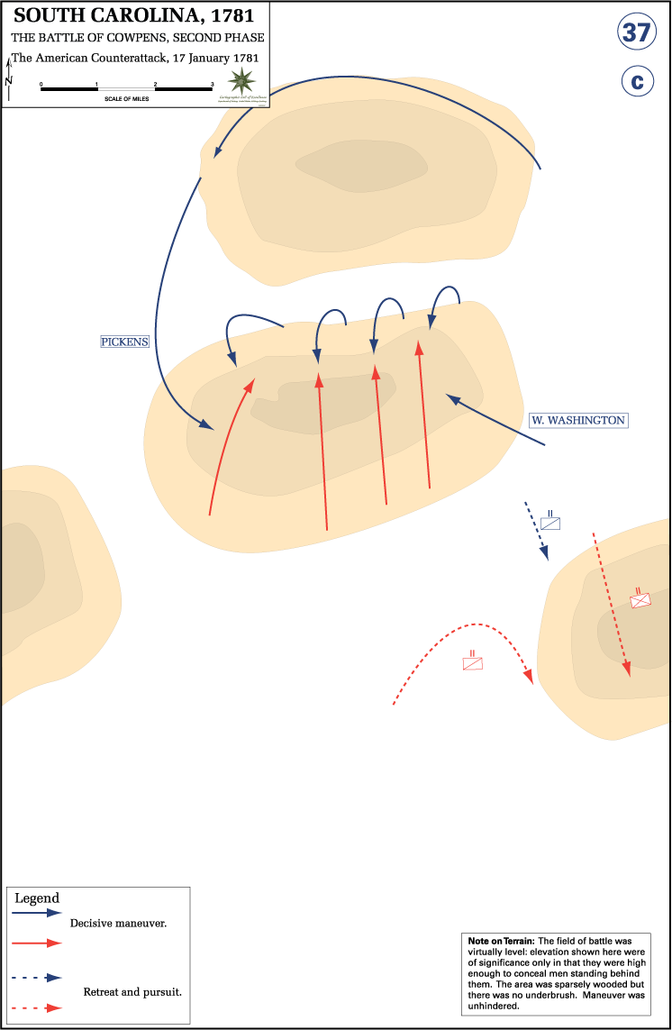
Phase 2

Slide 7
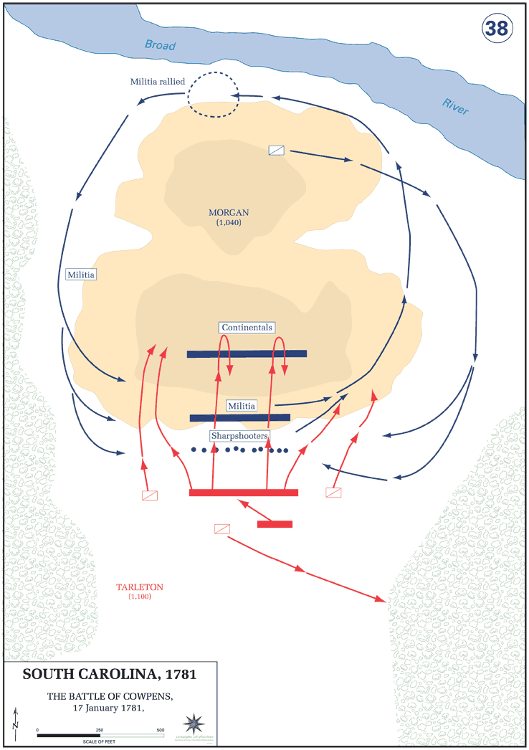
Conclusion

Slide 8
Aftermath
British Loss
Tarleton’s Dragoons – suffered 86% Casualty Rate
110 KIA
712 British prisoners
All Artillerymen killed or incapacitated
US Loss
128 Killed or wounded
Cornwallis’ Dragoons and Cavalry gone
Colonial victory – raises morale, boosts support throughout Colonies
Battle of Guilford Court - Pyrrhic victory that damaged Cornwallis’ Army
Departure from the south to Yorktown
Hazzah!!!!!

